Slide 1
Student Exam
Registration Number Setup & Allocation

Slide 2
How to Login in to the system

Slide 3
We can login/sign in to CMS in two ways Throgh website
Or throgh URL
www.uom.edu.pk
cms.uom.edu.pk
<number>

Slide 4
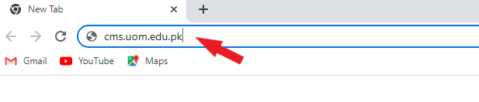
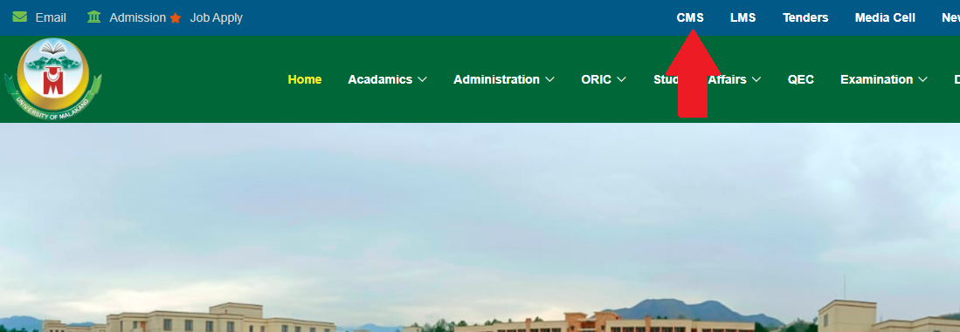
Through URL
Open a web browser (Google Chrome, Firefox, Microsoft Edge) whatever you use. When a browser is open type the following URL:
cms.uom.edu.pk
Through University website
Open university website, click on CMS in the
top menu, it will navigate you to the
login page.
<number>

Slide 5
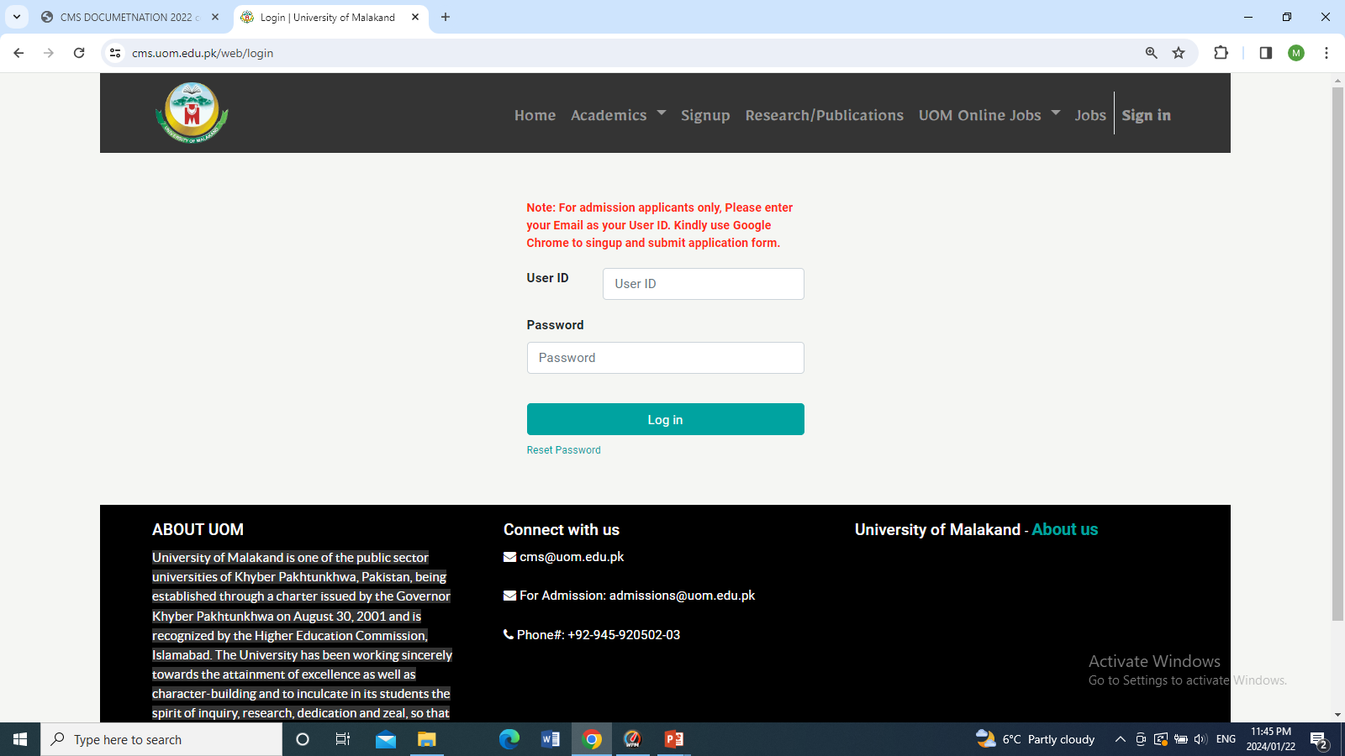
How to log in?
After typing the URL or Click on CMS in website you will see the following page which contains the login form enter your user id and password and click on the login button.

Slide 6
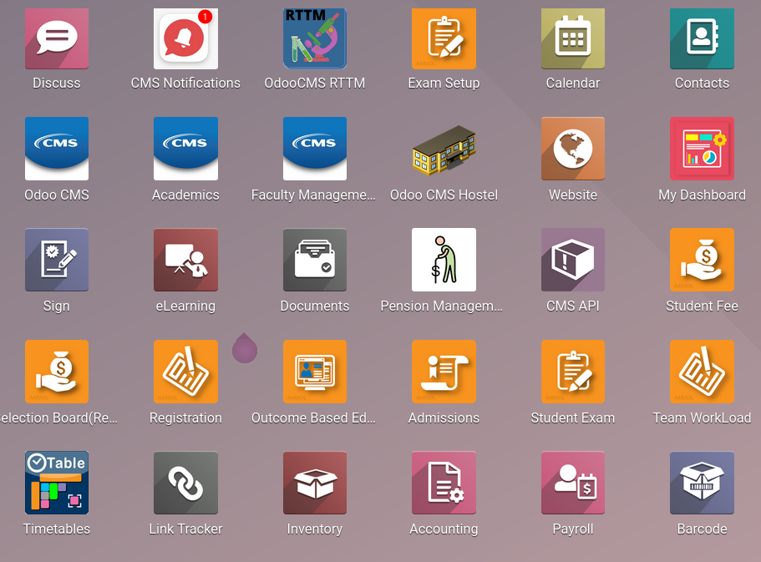
For Registration Number Setup & allocation click on Student Exame Module

Slide 7
Registration Number allotment contains Two
Main steps
Registration Number Setup
Registration Allocation
<number>

Slide 8
Registration Number Setup
<number>

Slide 9
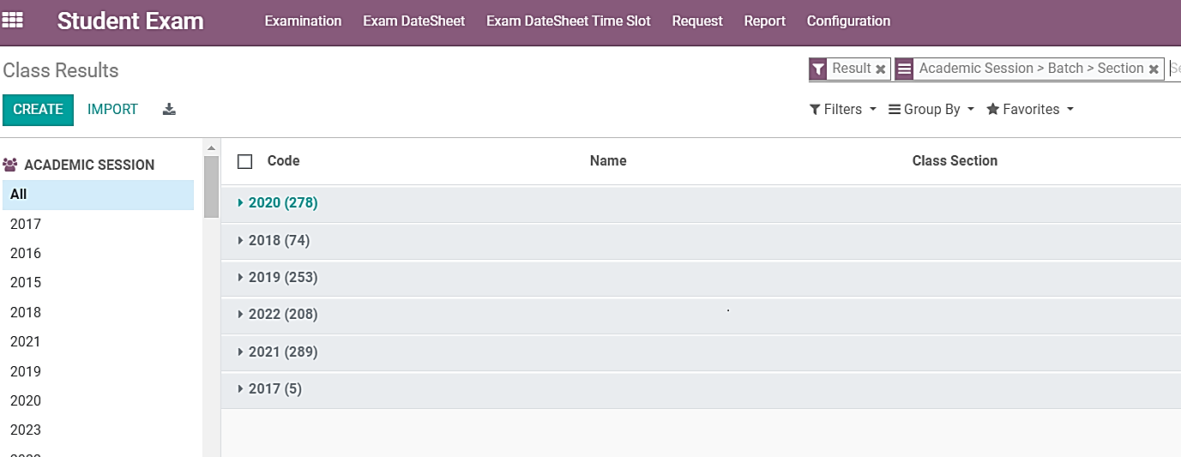
When we click on the Student Exam module, the following interface will be shown to us

Slide 10
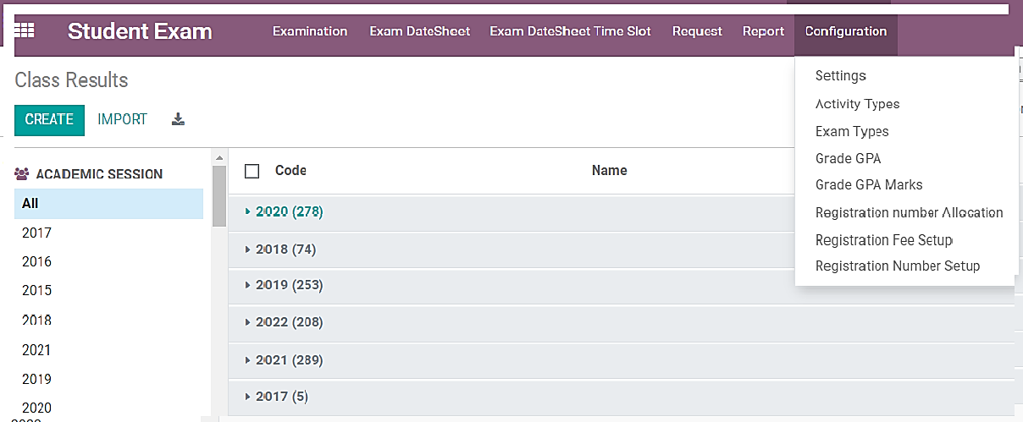
To set up registration numbers, we will click on 'Configuration,' and inside Configuration, we will click on 'Registration No Setup,' as shown below, circled

Slide 11
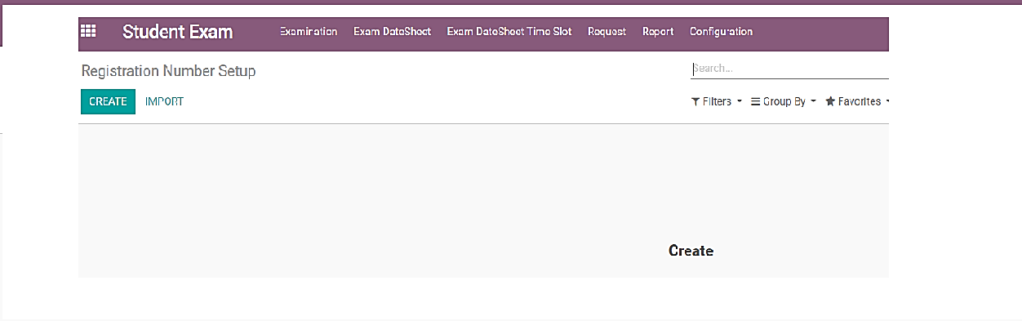
When we click on 'Registration Number Setup,' the following page will open. To create a registration number setup, we will click on the 'Create' button

Slide 12
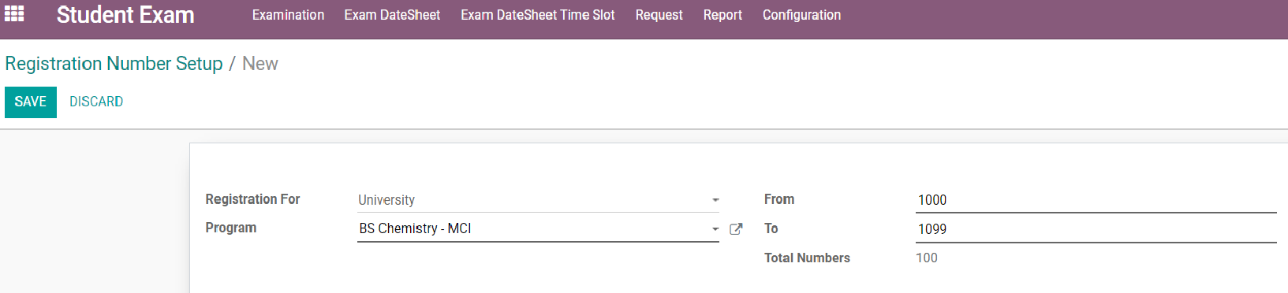
After clicking on the 'Create' button, the following interface will open
Select the university, college, or private option for which you want to set up registration numbers
Enter the starting number. The registration number will start from this number
Select the program for which the registration number setup can be configured
Enter the ending number. The registration number will stop at this number for the specific program
We do not enter the prefix manually, for example, 22 or 23, etc. The system will fetch the prefix automatically. For example, if we are assigning registration numbers to BS Chemistry for the 2022 session, the prefix '22' will be automatically generated by the system, i.e., 221000. After making all these changes, click on the 'Save' button to save the setup

Slide 13
Registration Number Allocation

Slide 14
After setting up the registration numbers, the next step is registration number allocation. To allocate registration numbers, within the student exam module, we will again click on 'Configuration,' and inside Configuration, we will click on 'Registration Number Allocation,' as clearly shown in the picture

Slide 15
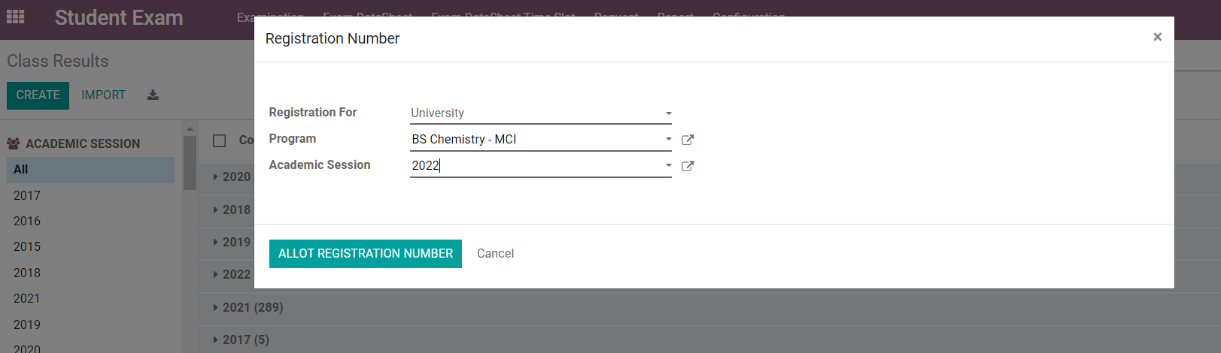
When we click on registration number allocation, we will see the following interface
Choose the university, college, or private institution for which you wish to allocate registration numbers
Select the program for which to allot registration numbers
Enter the session for which you intend to allocate registration numbers
After entering the above data, click on 'Allot registration number’
Upon clicking on 'Allot Registration Number,' all students of the BS Chemistry session 2022 will be assigned registration numbers within the range specified in the setup. It's important to note that this step cannot be completed before setting up registration number setup.

Slide 16
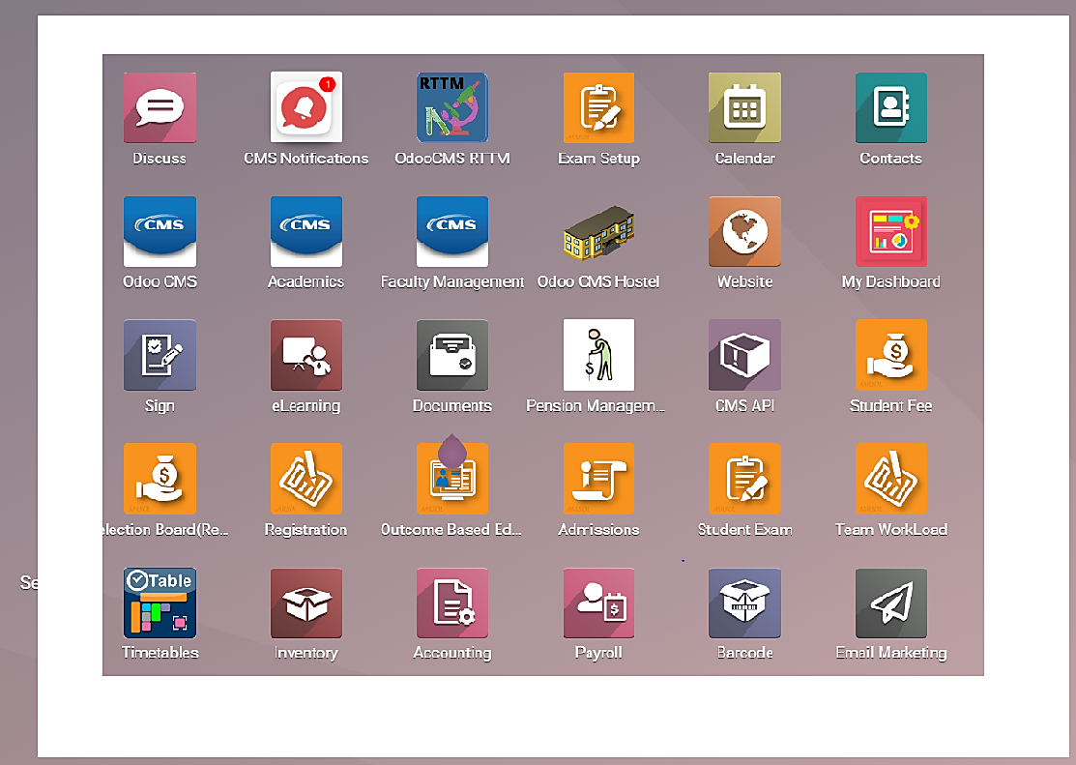
To confirm the registration number allotment against students, we will click on the Odoo CMS module, as indicated in the circle below

Slide 17
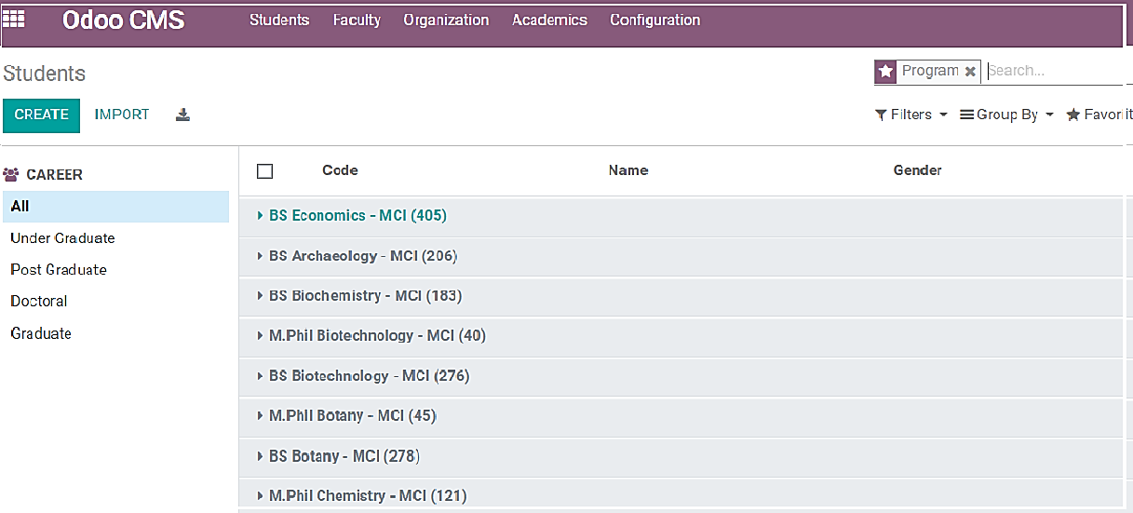
Upon clicking on the Odoo CMS module, we will encounter the following interface
The students record will appear program-wise by default

Slide 18
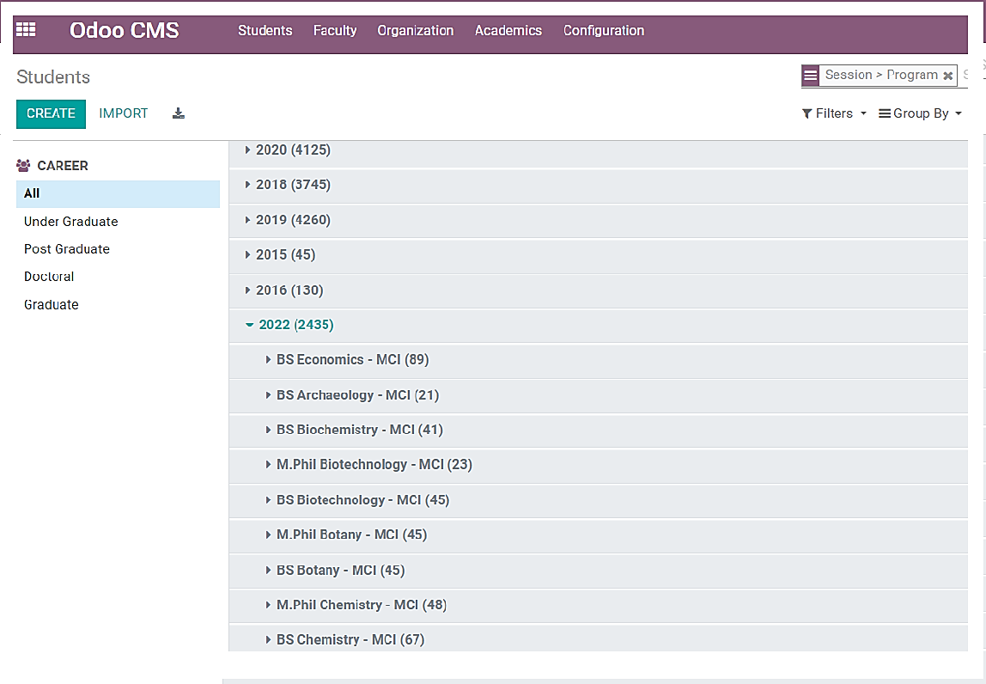
To view the student registration allotment session-wise and then program-wise, we will apply group by session and then by program. The navigation is as follows:
Navigate to 'Group by session > program', as indicated in the picture with a yellow circle.
With this grouping, we will first see the student records session-wise. Then, within each session, we will observe the student records
program-wise

Slide 19
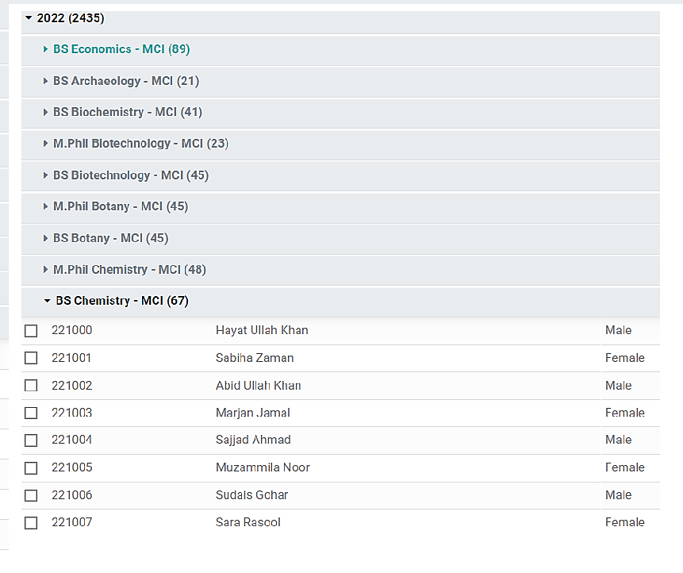
Now, to view the student registration number allotment for a specific program, we will click on that program. The student records will open in a list view with their registration numbers. Let's open BS Chemistry for the 2022 session, as we allocated registration numbers to BS Chemistry in our continuous training session
These are the registration numbers assigned to students. The starting number is 1000, as specified in the registration number setup. Additionally, the prefix '22' is added because of the session, preceding the starting number 1000

Slide 20
Thanks!
Any questions?
<number>

